Slide 1
Alstom GHCP Adoption

Slide 2



What is Required ?
GitHub account
Copilot license
Supported IDE
Notes:
SPEAKER NOTES: These are the 3 main components required to run Copilot or Copilot Chat. Pretty simple! [OPTIONAL] We are not going into the details of installing Copilot in the IDE, since there are several of them and the information is available online.

Slide 3



Let’s code
Today
Ready
Duration
Lab
Pre- requisites
Developers GHCP enabled in VS Code or Visual Studio 2022
Intro and demo (1h)
Hand on Labs (1h)
Examples and exercise are focused on C# and C++ Languages

Slide 4
Recap from envision phase
Summary of topic covered in 2 envision sessions
Introduction to GenAI and GHCP
Setup and Prepare the IDE Environment
Introduction of GHCP Capabilities
GHCP Interaction methods
Prompt Engineering
Q&A and Clarifications

Slide 5
Workshops Agenda
 | # | Activities | Description | Duration (minutes)
Intro | 1 | Quick recap on Github copilot introduction | Recap from the previous Envision sessions | 20
 | 2 | Introduction to Prompt Engineering | Importance of context, samples of good quality prompts, various interaction option (inline chat, chat, auto completion.)
 | 3 | Shortcuts | Productivity tips to leverage GitHub Copilot
Lab Level 1 | 4 | Conduct live demonstrations of GitHub Copilot and facilitate hands-on sessions for the following scenario: | Quick demo and Launch the lab 1 | 30
 | 5 | Green Field development | Create code snippet for a newly created file or project
 | 6 | Regex | Use GitHub copilot to create a regex function that validates GUID string and IPV6 address string
 | 7 | Validator | Use GitHub copilot to create a function to validate text input
 | 8 | Unit Test Code Generation | Use GitHub copilot to generate test cases for any selected code snippet or entire file
 | 9 | Data Connection | Use GitHub copilot to build a data access class with CRUD operation for accessing a SQL database
 | 10 | File Operation | Use GitHub copilot to create a function to perform sample file operation like read file.
 | X | Feedback and tips
Lab Level 2 | 11 | Conduct live demonstrations of GitHub Copilot and facilitate hands-on sessions for the following scenario: | Quick demo and Launch the lab 2 | 30
 | 12 | Generate functional tests in Gerkin | Try to generate functional tests from requirements
 | 13 | Explain Code | Showcase GitHub copilot /explain command
 | 14 | Fix Bug | Try GitHub copilot to identify any sample code's vulnerabilities and its capability to suggest bug fixes.
 | 15 | Debug | Try GitHub copilot along with IDE/Visual Studio to debug a code snippet and showcase copilot's suggestion.
 | 16 | Steps | Showcase GitHub copilot to build set to steps to carry out a use case.
 | 17 | Code Optimization | Try GitHub copilot to optimize a code snippet for demonstration
 | X | Feedback and tips
Lab Level 3 | 18 | Lab Exercise | Hands on Exercise: 1. Create a simple Web API using .NET (REST) project with the help of GitHub Copilot. 2- Add method and unit tests 4. (Bonus) Create an Azure webapp resource using Terraform using GitHub copilot 5. (Bonus) Generate CI/CD workflows for building and deploying onto Azure using GitHub copilot | 40
 |  | Total |  | 120 (2h)

Slide 6
Prompt Engineering RECAP
WHAT - Prompt engineering is the process of designing and creating high-quality prompts that can be used to generate accurate and useful code suggestions with Copilot.
WHY
Maximizes utility of Copilot
Minimizes repeated iterations
Determines code suggestion quality
Skill prompts guide Copilot to understand context & nuances
Refined interactions reduces misunderstandings
How
Specify - Narrow down your prompt to be targeted
Contextual Understanding - Comments, Function names, it all helps
Efficiency - Write it clearly once and avoid multiple prompts
Quality of Response - The more you give copilot, the stronger your response
Refine
Control Output Verbosity
Provide Examples
Give Direction
Format your Response
Evaluate Quality
Chaining Prompts
https://platform.openai.com/docs/guides/prompt-engineering/six-strategies-for-getting-better-results

Slide 7
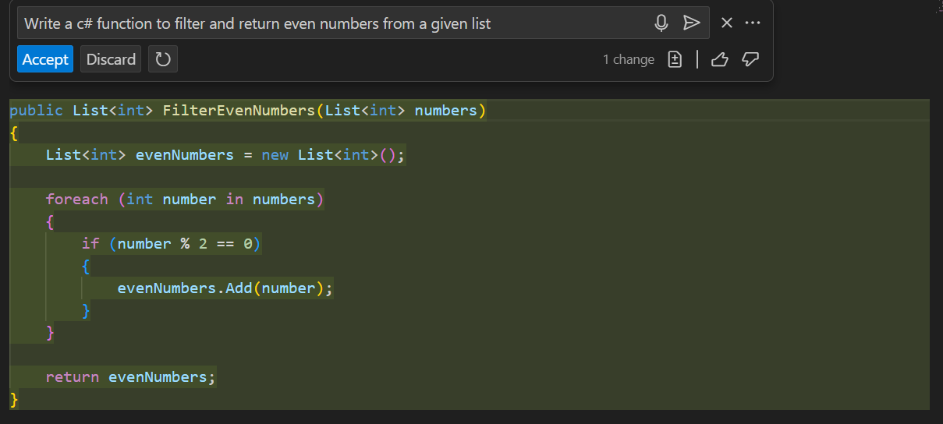
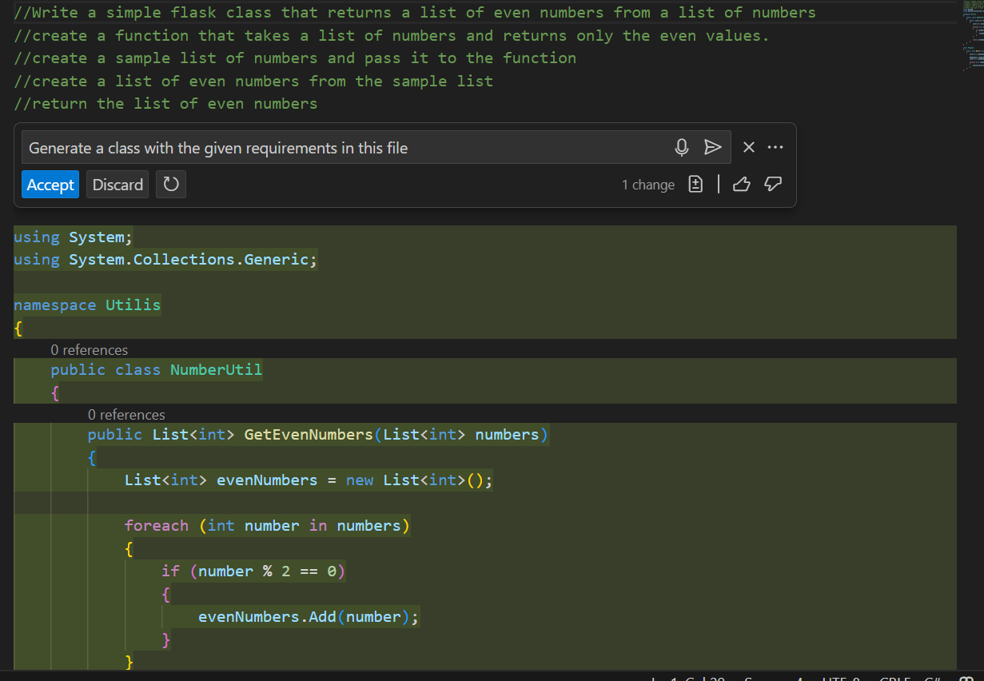
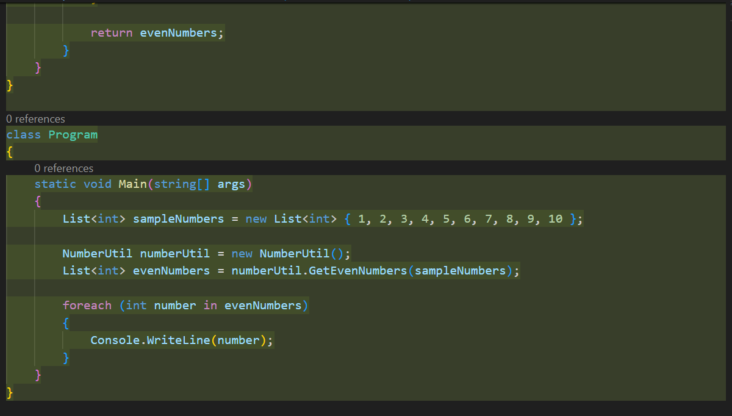
Best Practices in Prompt engineering
Bad Prompt
Good Prompt
Leverage comments to add more context to your prompt
https://platform.openai.com/docs/guides/prompt-engineering/six-strategies-for-getting-better-results
Notes:
Provide enough clarity
Provide enough context with details
Provide examples for learning
Assert and iterate - Unlocking GitHub Copilot's full potential is the practice of iteration.

Slide 8
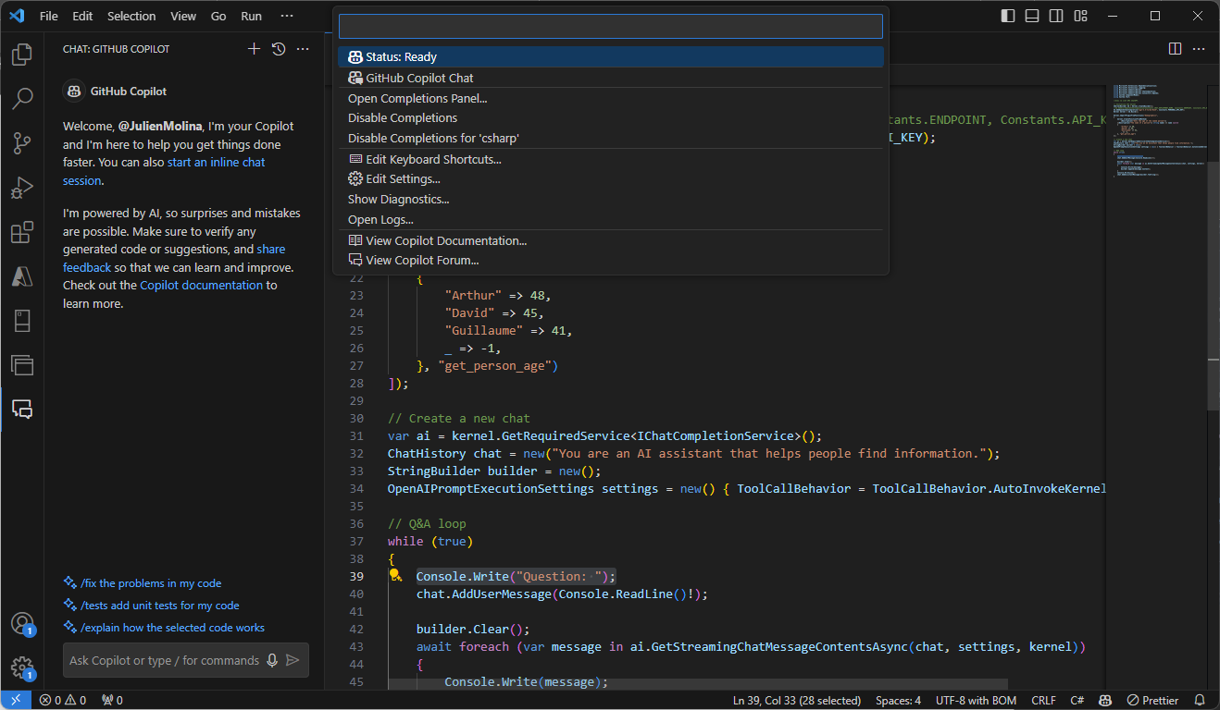
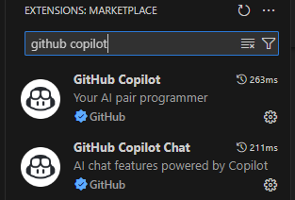
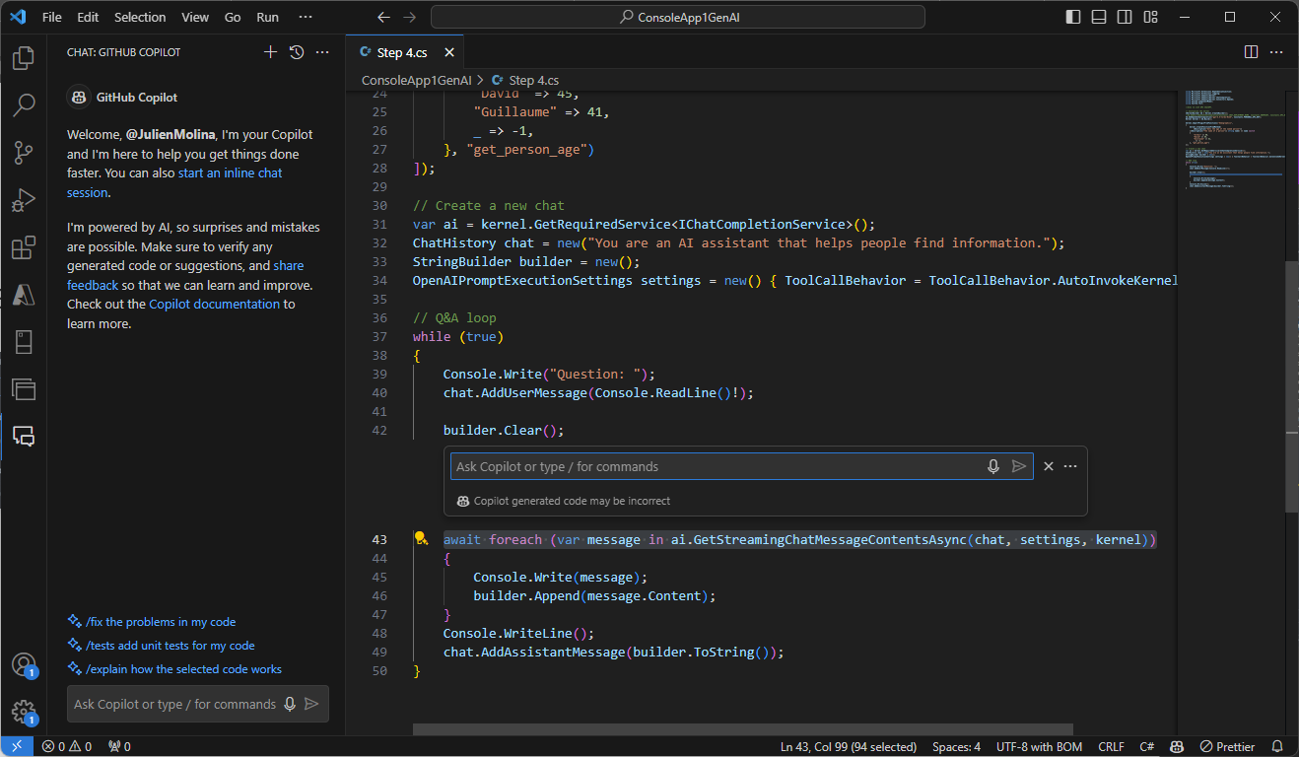
Copilot in Visual Studio Code IDE
GitHub
Copilot config
IDE Extensions
GitHub
Copilot Chat
Inline Chat GitHub
Copilot
Notes:
SPEAKER NOTES: Once Copilot is enabled from the GitHub side and your Copilot IDE extensions are installed, you should be able to see certain Copilot related icons on your IDE. In this case we are showing you Visual Studio Code. Clicking on Copilot Chat and Copilot Lab will open UI options to interact with these extensions, the core Copilot extension does not require an additional UI, since it mostly operates from within your code file.

Slide 9
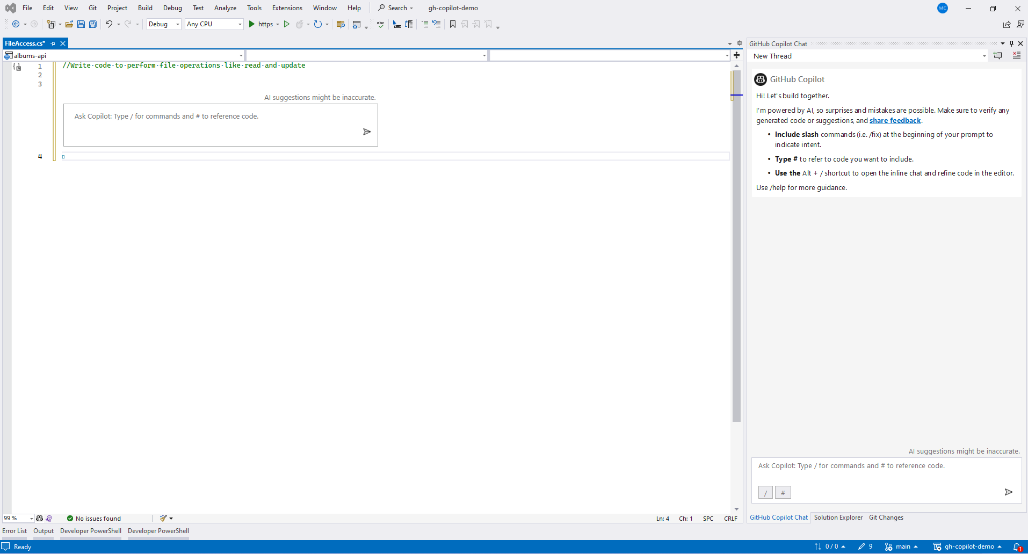
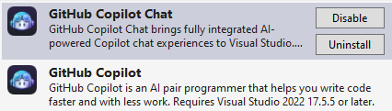
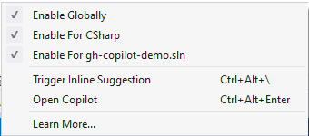
Copilot in Visual Studio IDE
IDE Extensions
Inline Chat GitHub
Copilot
GitHub
Copilot Chat
GitHub
Copilot config

Slide 10
When to use Copilot vs Copilot Chat
GitHub Copilot
GitHub Copilot Chat
Direct Code Writing
In-Depth Assistance
Seamless IDE Integration
Learning & Teaching
Solo Development
Collaborative Scenarios
Notes:
SPEAKER NOTES: GitHub Copilot and Copilot Chat serve different purposes, and the choice between them would be based on the specific use-case and the interaction you're looking for. Here are some scenarios in which you might choose one over the other:
GitHub Copilot:
Direct Code Writing:
When you're actively writing code and want auto-suggestions inline within your IDE.
For quick code snippets, standard patterns, or commonly-used functions.
Seamless IDE Integration:
Copilot is directly integrated into the Visual Studio Code (VS Code) environment, so if you're coding within VS Code, it provides a seamless experience.
Solo Development:
If you're working on your own, Copilot can act like a pair-programming partner, suggesting code as you type.
Copilot Chat:
In-Depth Assistance:
If you want a more interactive and explanatory assistance, akin to a chat with a mentor or experienced developer.
Great for understanding reasoning or getting more detailed explanations behind a piece of code.
Learning and Teaching:
Beneficial for newcomers to a programming language or concept, as the chat format can provide a more guided, step-by-step walkthrough.
Collaborative Scenarios:
If you have a complex problem and expect a bit of back-and-forth interaction to clarify and iterate on your requirements.
If you're working in a team setting and want to discuss a coding challenge or problem interactively, having a chat format might be beneficial to gather multiple perspectives.
While both tools are powered by advanced models and can aid in code generation, the choice boils down to the style of interaction you're seeking. For inline, direct coding suggestions, go with Copilot. For a more interactive, chat-based guidance, opt for Copilot Chat. Remember to always review and understand the code generated by either tool to ensure its correctness and appropriateness for your specific scenario.

Slide 11


GitHub COpilot Shortcuts
Action | Shortcuts |  | Command Name
 | Visual Studio Code | Visual Studio
Open Inline Chat | Ctrl+I | Alt+/
Accept an inline suggestion | Tab | Tab | editor.action.inlineSuggest.commit
Dismiss an inline suggestion | Esc | Esc | editor.action.inlineSuggest.hide
Show next inline suggestion | Alt+] | Alt+] | editor.action.inlineSuggest.showNext
Show previous inline suggestion | Alt+[ | Alt+[ | editor.action.inlineSuggest.showPrevious
Trigger inline suggestion | Alt+\ | Ctrl+Alt+\ | editor.action.inlineSuggest.trigger
Open Completions Panel (additional suggestions in separate pane) | Ctrl+Enter | Ctrl+Alt+Enter | github.copilot.generate
Include Slash | / | / | Slash Command /doc to add a documentation comment /explain to explain the code /fix to propose a fix for the problems in the selected code /generate to generate code to answer your question /help to get help on Copilot Chat /optimize to analyze and improve running time of the selected code /tests to create unit tests for the selected code
Type # | # | # | to refer to the code file in the repo => #Myfiles.cs
Reference : https://devblogs.microsoft.com/visualstudio/copilot-chat-slash-commands-and-context-variables/
Notes:
Add the shortcut and demo while working.

Slide 12
Sample Code repository
C#
Fork the sample repo
Clone the repo: `git clone https://github.com/Avanade-Client-Gallia-Alstom/GH-Copilot-CSharpCode.git `
Open the cloned repo in Visual Studio
C++
Fork the sample repo
Clone the repo: `git clone https://github.com/Avanade-Client-Gallia-Alstom/GHCPLabExerciseC-.git
Open the cloned repo in VS Code

Slide 13
C# Section

Slide 14
C# Demo – Use cases
 | # | Activities | Description | Duration (minutes)
Intro | 1 | Quick recap on Github copilot introduction | Recap from the previous Envision sessions | 20
 | 2 | Introduction to Prompt Engineering | Importance of context, samples of good quality prompts, various interaction option (inline chat, chat, auto completion.)
 | 3 | Shortcuts | Productivity tips to leverage GitHub Copilot
Lab Level 1 |  | Conduct live demonstrations of GitHub Copilot and facilitate hands-on sessions for the following scenario: | Quick demo and Launch the lab 1 | 30
 | 4 | Green Field development | Create code snippet for a newly created file or project
 | 5 | Regex | Use GitHub copilot to create a regex function that validates GUID string and IPV6 address string
 | 6 | Validator | Use GitHub copilot to create a function to validate text input
 | 7 | Unit Test Code Generation | Use GitHub copilot to generate test cases for any selected code snippet or entire file
 | 8 | Data Connection | Use GitHub copilot to build a data access class with CRUD operation for accessing a SQL database
 | 9 | File Operation | Use GitHub copilot to create a function to perform sample file operation like read file.
 | 10 | Custom Coding Standard | Use GitHub copilot to showcase custom coding standard assistance.
 | 11 | Feedback Demo - Multithreading scenario with worker thread and main thread.​ | Use GitHub copilot to showcase multithreading demo on windows application
 |  | Feedback and tips
Lab Level 2 |  | Conduct live demonstrations of GitHub Copilot and facilitate hands-on sessions for the following scenario: | Quick demo and Launch the lab 2 | 30
 | 12 | Explain Code | Showcase GitHub copilot /explain command
 | 13 | Fix Bug | Try GitHub copilot to identify any sample code's vulnerabilities and its capability to suggest bug fixes.
 | 14 | Debug | Try GitHub copilot along with IDE/Visual Studio to debug a code snippet and showcase copilot's suggestion.
 | 15 | Steps | Showcase GitHub copilot to build set to steps to carry out a use case.
 | 16 | Code Optimization | Try GitHub copilot to optimize a code snippet for demonstration
 |  | Feedback and tips
Lab Level 3 | 1 | Lab Exercise | Hands on Exercise: 1. Create a simple Web API using .NET (REST) project with the help of GitHub Copilot. 2- Add method and unit tests 4. (Bonus) Create an Azure webapp resource using Terraform using GitHub copilot 5. (Bonus) Generate CI/CD workflows for building and deploying onto Azure using GitHub copilot | 40
 |  | Total |  | 120 (2h)

Slide 15
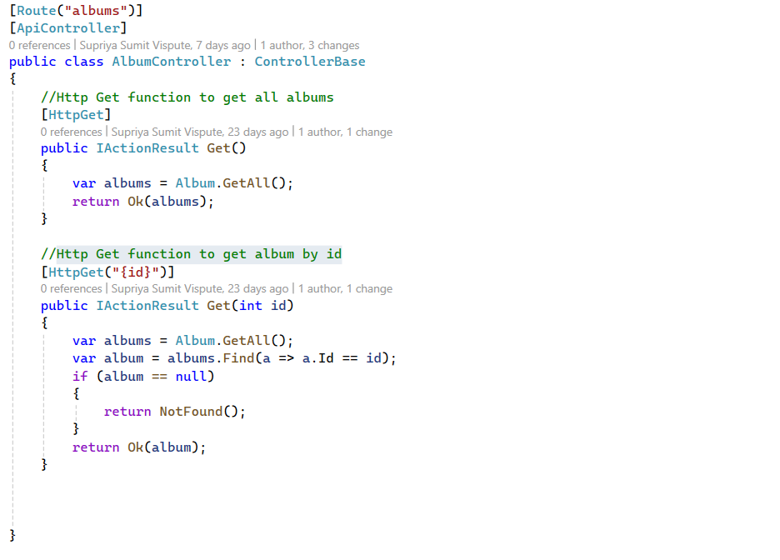
Demo – Green Field development
Capability: Generate new code
Example: Create code snippet for a newly created file or project.
Demo File name -
albums-api/Controller/AlbumController.cs
Notes:
Generate function to get all albums using the Album model
Generate function to get album by id using the Album model

Slide 16
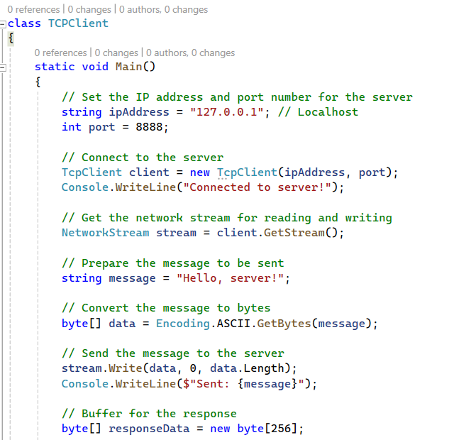
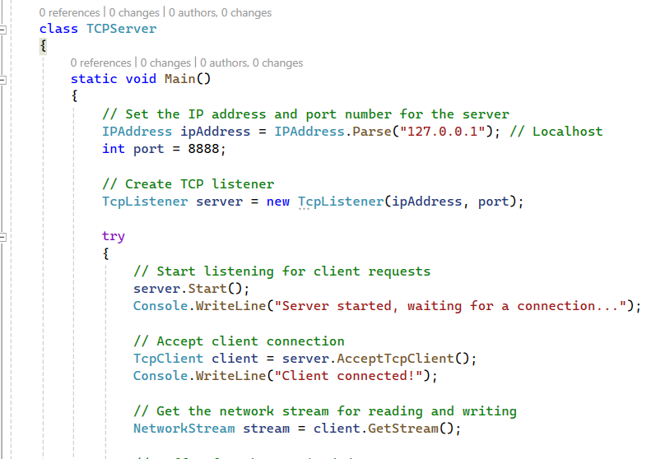
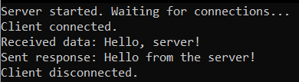
Demo – GREEN FIELD DEVELOPMENT
Capability: Generate a new windows application code.
Example: Generate a C# program to perform a TCP communication.
Demo File name -
TCPClient/TCPClient.cs
TCPServer/TCPServer.cs
Notes:
Generate a C# program for TCP server, Generate a C# program for TCP Client

Slide 17
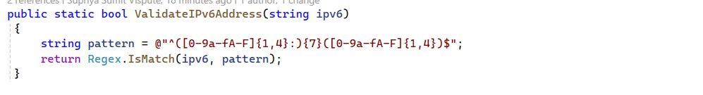
Demo – REGEX
Capability: Regex
Example: Use GitHub copilot to create a regex function that validates IPV6 address, email address and phone number string.
Demo File name -
albums-api/utilis/Validations.cs
Notes:
Generate Regex functions to validate IPV6 address
Additional Exercise:
Generate function that validates the format of a GUID string

Slide 18
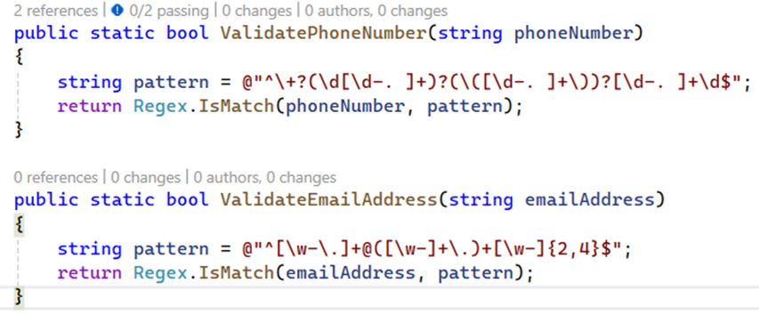
Demo – VALidator
Capability: Validator
Example: Create a new function to
validate text input
Demo File name -
album-viewer/utils/validators.cs
Notes:
Generate Regex functions to validate phone number and email address

Slide 19
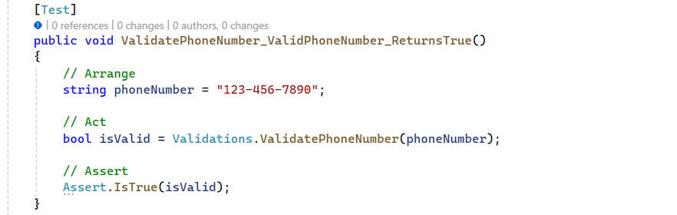
Demo – unit test code generation
Capability: Unit Test Code generation
Example: Generate test cases for any selected code snippet or entire file.
Demo File name -
albums-nunit/ValidationsTests.cs
Notes:
Generate test case for the selected code snippet

Slide 20
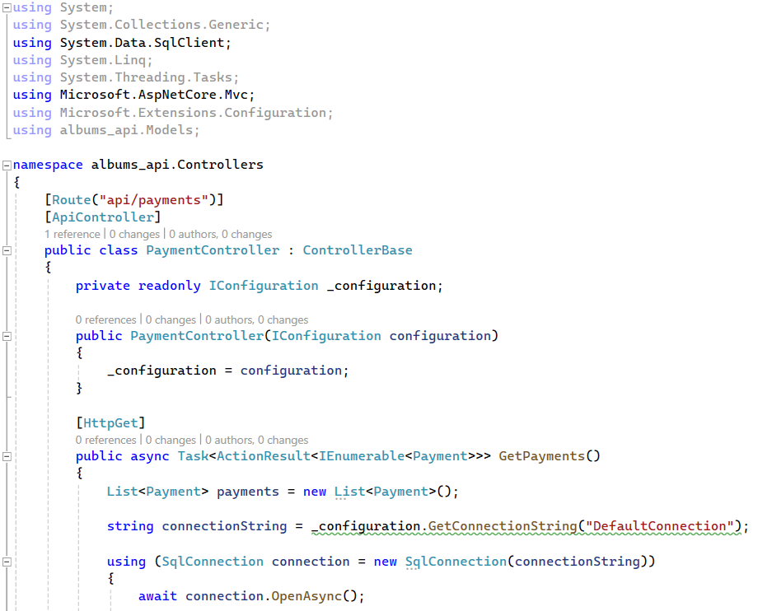
Demo – DATA connection
Capability: Data operation codebase
Example: Use GitHub copilot to build a data access class with CRUD operation for accessing a SQL database.
Demo File name -
albums-api/Controller/PaymentController.cs
Notes:
create a Http Get api to fetch all the payments using classic SqlDbConnection referring Class Payment under Model folder

Slide 21
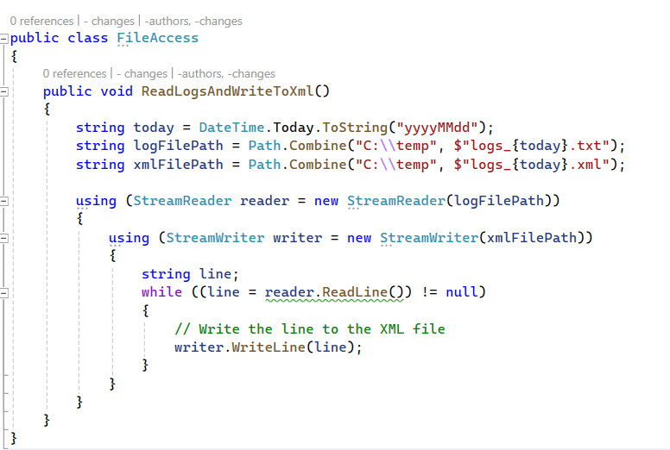
Demo – File Operation
Capability: File operation codebase
Example: Create a function to perform file operation.
Demo File name -
albums-api/Utilis/FileAccess.cs
Notes:
Create a function to Read logs of todays date from c drive temp folder and write it to an xml file in the same location using streamwriter

Slide 22
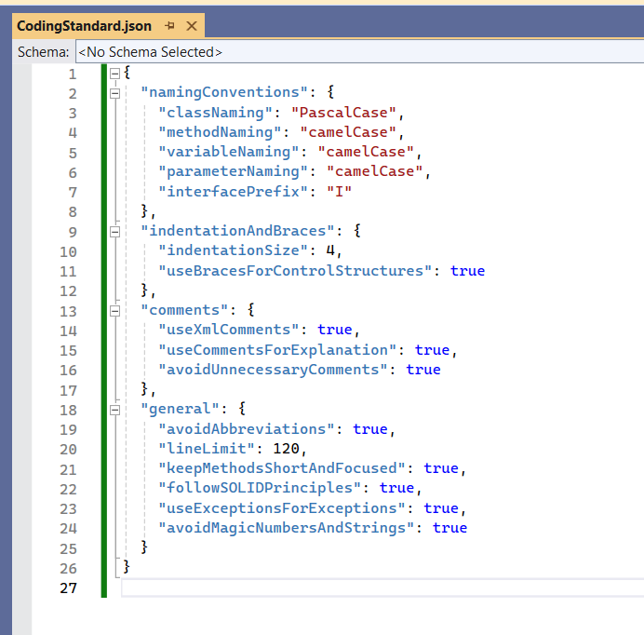
Demo – Coding Standard assistance
Capability: Coding Standard Assistance
Example: Create a function that follows a sample C# coding standard file.
Demo File name -
albums-api/Utilis/DemoCodingStandard.cs
Notes:
Create a function following coding standard file #file:'CodingStandard.json' to check if a string is a palindrome

Slide 23
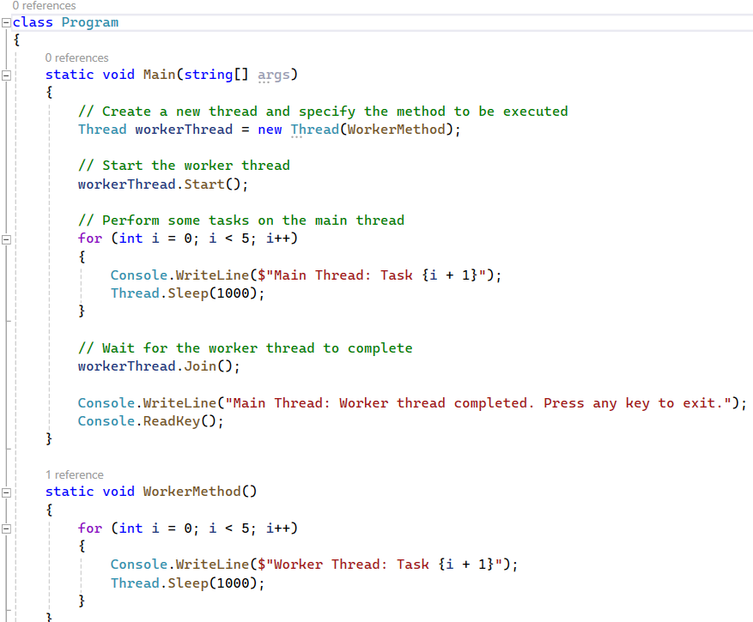
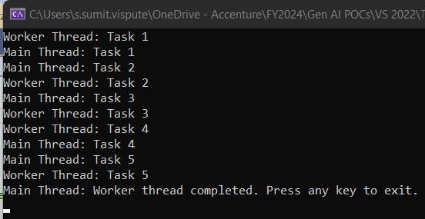
Demo – Multithreading operation
Capability: Multithreading operation
Example: Create a C# console application to demonstrate multithreading using GitHub Copilot's suggestions. The application should showcase the creation of a separate worker thread that executes tasks concurrently with the main thread.
Demo File name -
Multithreading/Program.cs
Notes:
"Generate a multithreaded C# program using coding standards in #file:'CodingStandard.json' for each method created to demonstrate usecase - where two threads attempt to access the same resource (a file), utilize locking to ensure thread safety."

Slide 24



Feedback and tips
You
Feedbacks
Features
As Developer
As Techlead
What is your favorite feature?
Green Field development
Regex
Validator
Unit Test Code Generation
Data Connection
File Operation
Or discovered during this part

Slide 25
C# Demo – Use cases
 | # | Activities | Description | Duration (minutes)
Intro | 1 | Quick recap on Github copilot introduction | Recap from the previous Envision sessions | 20
 | 2 | Introduction to Prompt Engineering | Importance of context, samples of good quality prompts, various interaction option (inline chat, chat, auto completion.)
 | 3 | Shortcuts | Productivity tips to leverage GitHub Copilot
Lab Level 1 |  | Conduct live demonstrations of GitHub Copilot and facilitate hands-on sessions for the following scenario: | Quick demo and Launch the lab 1 | 30
 | 4 | Green Field development | Create code snippet for a newly created file or project
 | 5 | Regex | Use GitHub copilot to create a regex function that validates GUID string and IPV6 address string
 | 6 | Validator | Use GitHub copilot to create a function to validate text input
 | 7 | Unit Test Code Generation | Use GitHub copilot to generate test cases for any selected code snippet or entire file
 | 8 | Data Connection | Use GitHub copilot to build a data access class with CRUD operation for accessing a SQL database
 | 9 | File Operation | Use GitHub copilot to create a function to perform sample file operation like read file.
 | 10 | Custom Coding Standard | Use GitHub copilot to showcase custom coding standard assistance.
 | 11 | Feedback Demo - Multithreading scenario with worker thread and main thread.​ | Use GitHub copilot to showcase multithreading demo on windows application
 |  | Feedback and tips
Lab Level 2 |  | Conduct live demonstrations of GitHub Copilot and facilitate hands-on sessions for the following scenario: | Quick demo and Launch the lab 2 | 30
 | 12 | Explain Code | Showcase GitHub copilot /explain command
 | 13 | Fix Bug | Try GitHub copilot to identify any sample code's vulnerabilities and its capability to suggest bug fixes.
 | 14 | Debug | Try GitHub copilot along with IDE/Visual Studio to debug a code snippet and showcase copilot's suggestion.
 | 15 | Steps | Showcase GitHub copilot to build set to steps to carry out a use case.
 | 16 | Code Optimization | Try GitHub copilot to optimize a code snippet for demonstration
 |  | Feedback and tips
Lab Level 3 | 1 | Lab Exercise | Hands on Exercise: 1. Create a simple Web API using .NET (REST) project with the help of GitHub Copilot. 2- Add method and unit tests 4. (Bonus) Create an Azure webapp resource using Terraform using GitHub copilot 5. (Bonus) Generate CI/CD workflows for building and deploying onto Azure using GitHub copilot | 40
 |  | Total |  | 120 (2h)

Slide 26
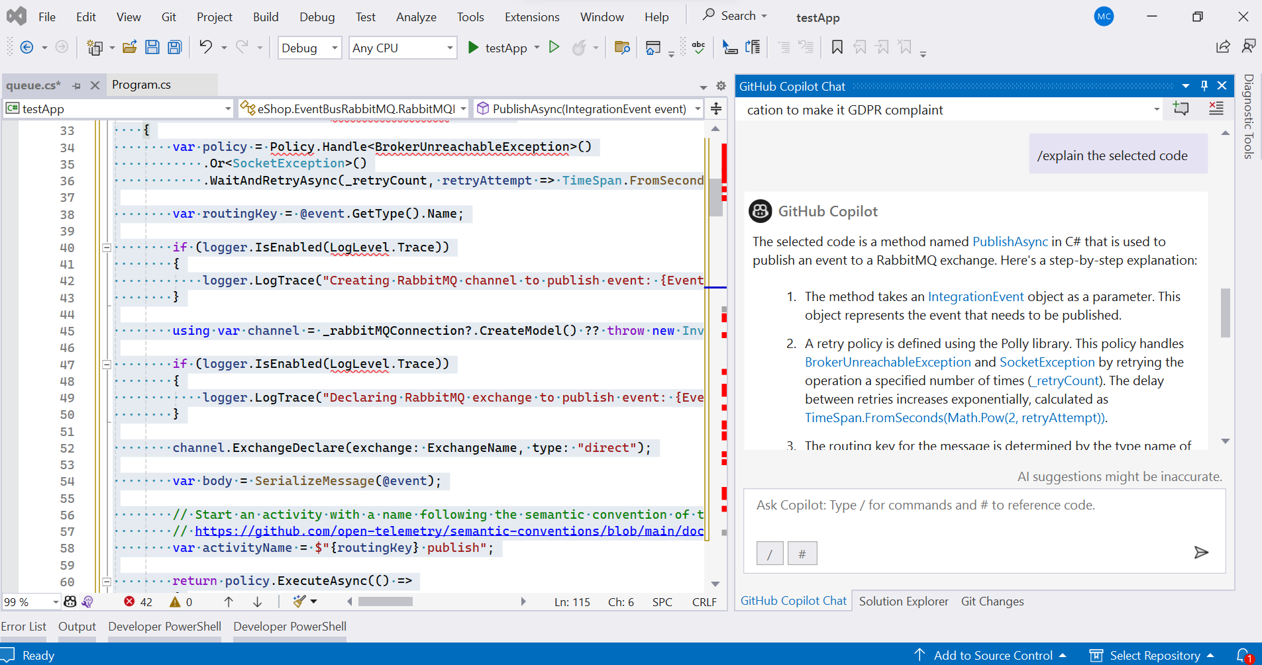
Demo – explain
Capability: Explain
Example: Explain the code snippet
Demo File name:
testApp\queue.cs
Notes:
Alt+/ -> Explain

Slide 27
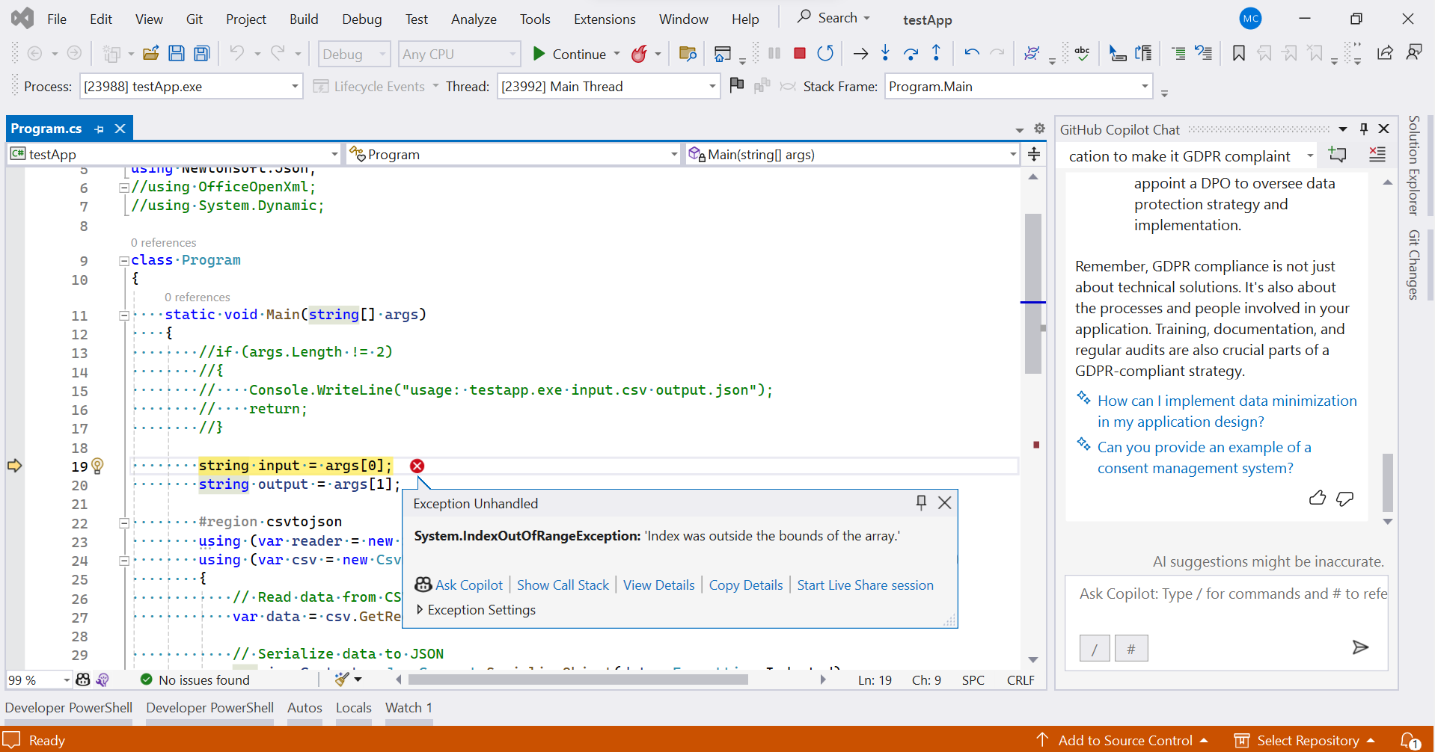
Demo – debug
Capability: Code debug support
Example: Debug a code snippet and showcase copilot's suggestion.
Demo File name:
testApp/Program.cs
Notes:
Exception -> Ask Copilot -> Preview -> Accept/Discard

Slide 28
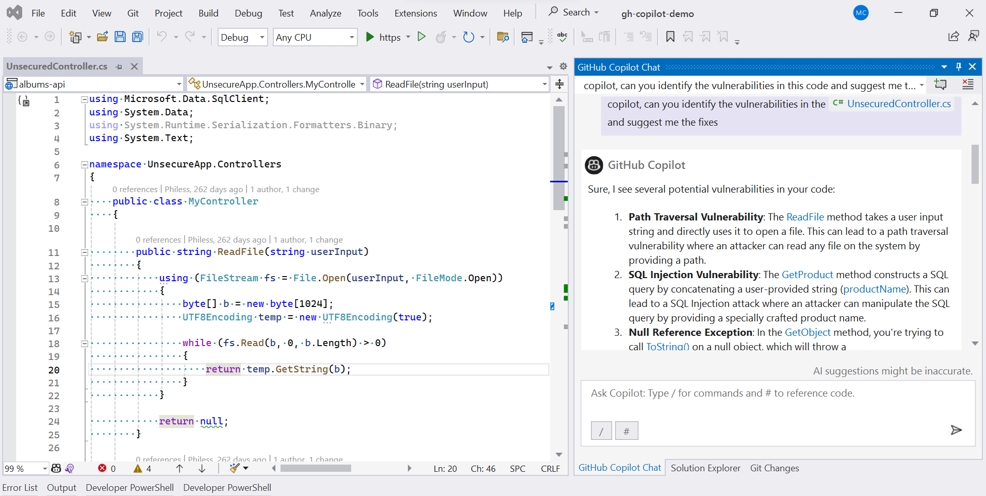
Demo – identify vulnerabilities & suggest Fix
Capability: Identify vulnerabilities and suggest fix
Example: Identify any sample code's vulnerabilities and its capability to suggest bug fixes.
Demo File name:
albums-api/Controllers/UnsecuredController.cs
Notes:
copilot, can you identify the vulnerabilities in the #UnsecuredController.cs and suggest me the fixes

Slide 29
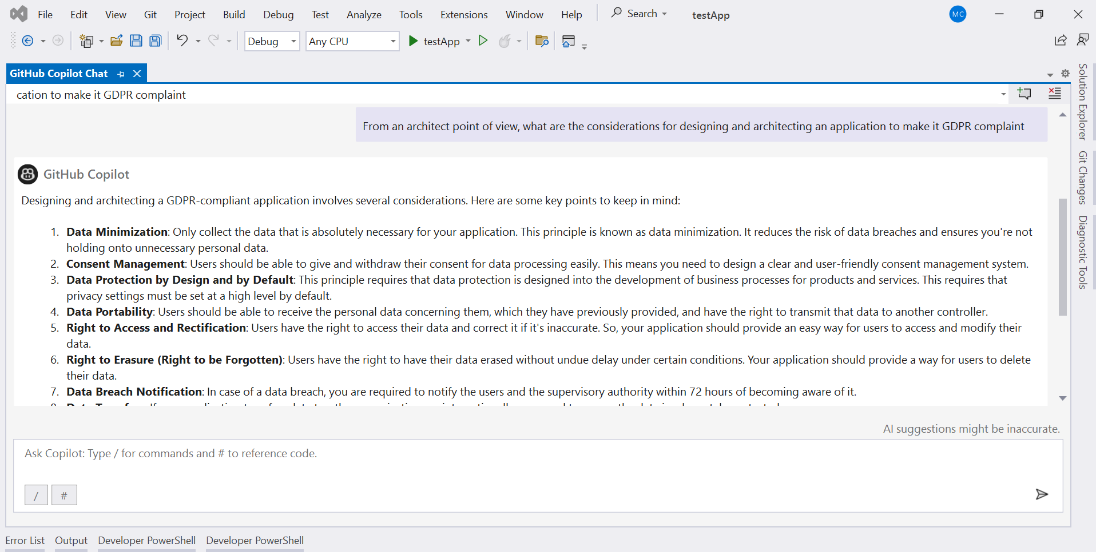
Demo – STEPS
Capability: General support and guidance
Capability: Conceptual Guidance
Example: Conceptual step-by-step guidance to carry out a use case
Notes:
Copilot, from an architect point of view, what are the considerations for designing and architecting an application to make it GDPR complaint

Slide 30
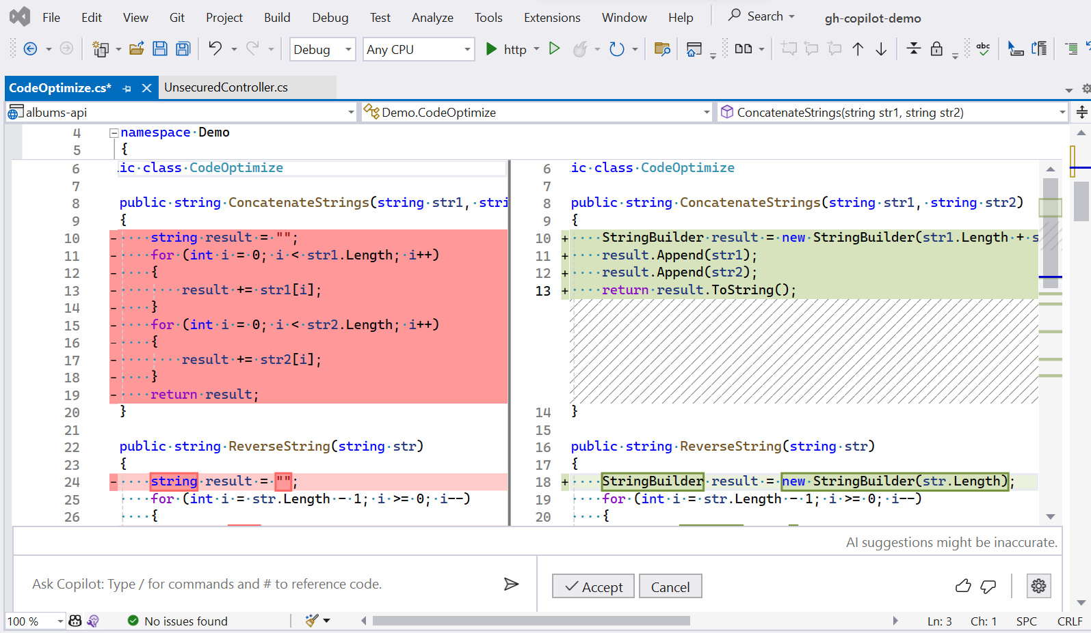
Demo – code optimize
Capability: Code optimization
Example: Optimize the given code snippet
Demo File name:
albums-api/Utilis/CodeOptimize.cs
Notes:
Copilot, can you optimize the selected code?

Slide 31
Feedback and tips
You
Feedbacks
Features
As Developer
As Techlead
What is your favorite feature?
Explain Code
Fix Bug
Debug
General support and guidance
Optimization
Or discovered during this part

Slide 32
C# Demo – Use cases
 | # | Activities | Description | Duration (minutes)
Intro | 1 | Quick recap on Github copilot introduction | Recap from the previous Envision sessions | 20
 | 2 | Introduction to Prompt Engineering | Importance of context, samples of good quality prompts, various interaction option (inline chat, chat, auto completion.)
 | 3 | Shortcuts | Productivity tips to leverage GitHub Copilot
Lab Level 1 |  | Conduct live demonstrations of GitHub Copilot and facilitate hands-on sessions for the following scenario: | Quick demo and Launch the lab 1 | 30
 | 4 | Green Field development | Create code snippet for a newly created file or project
 | 5 | Regex | Use GitHub copilot to create a regex function that validates GUID string and IPV6 address string
 | 6 | Validator | Use GitHub copilot to create a function to validate text input
 | 7 | Unit Test Code Generation | Use GitHub copilot to generate test cases for any selected code snippet or entire file
 | 8 | Data Connection | Use GitHub copilot to build a data access class with CRUD operation for accessing a SQL database
 | 9 | File Operation | Use GitHub copilot to create a function to perform sample file operation like read file.
 | 10 | Custom Coding Standard | Use GitHub copilot to showcase custom coding standard assistance.
 | 11 | Feedback Demo - Multithreading scenario with worker thread and main thread.​ | Use GitHub copilot to showcase multithreading demo on windows application
 |  | Feedback and tips
Lab Level 2 |  | Conduct live demonstrations of GitHub Copilot and facilitate hands-on sessions for the following scenario: | Quick demo and Launch the lab 2 | 30
 | 12 | Explain Code | Showcase GitHub copilot /explain command
 | 13 | Fix Bug | Try GitHub copilot to identify any sample code's vulnerabilities and its capability to suggest bug fixes.
 | 14 | Debug | Try GitHub copilot along with IDE/Visual Studio to debug a code snippet and showcase copilot's suggestion.
 | 15 | Steps | Showcase GitHub copilot to build set to steps to carry out a use case.
 | 16 | Code Optimization | Try GitHub copilot to optimize a code snippet for demonstration
 |  | Feedback and tips
Lab Level 3 | 1 | Lab Exercise | Hands on Exercise: 1. Create a simple Web API using .NET (REST) project with the help of GitHub Copilot. 2- Add method and unit tests 4. (Bonus) Create an Azure webapp resource using Terraform using GitHub copilot 5. (Bonus) Generate CI/CD workflows for building and deploying onto Azure using GitHub copilot | 40
 |  | Total |  | 120 (2h)

Slide 33
Lab Exercise
Use Case:
Create a simple web Api using .NET with the help of GitHub copilot.
Generate CI/CD workflows for building and deploying onto Azure using GitHub Copilot.
GitHub URL: https://github.com/Avanade-Client-Gallia-Alstom/CopilotWebAPI

Slide 34
C++ Section

Slide 35
C++ Demo – Use cases
 | # | Activities | Description | Duration (minutes)
Intro | 1 | Quick recap on Github copilot introduction | Recap from the previous Envision sessions | 20
 | 2 | Introduction to Prompt Engineering | Importance of context, samples of good quality prompts, various interaction option (inline chat, chat, auto completion.)
 | 3 | Shortcuts | Productivity tips to leverage GitHub Copilot
Lab Level 1 |  | Conduct live demonstrations of GitHub Copilot and facilitate hands-on sessions for the following scena.rio: | Quick demo and Launch the lab 1 | 30
 | 4 | Green Field development | Create code snippet for a newly created file or project
 | 5 | Regex | Use GitHub copilot to create a regex function that validates Credit Card number.
 | 6 | Validator | Use GitHub copilot to create a function to validate Credit Card number using Luhn Algorithm.
 | 7 | Unit Test Code Generation | Use GitHub copilot to generate test cases for any selected code snippet or entire file
 | 8 | Data Connection | Use GitHub copilot to build a data access class with CRUD operation for accessing a SQL server.
 | 9 | File Operation | Use GitHub copilot to create a function to read log files from download folder in C drive and print in the console.
 | 10 | Complex Algorithm | Implement Dijkstra's Algorithm in C++ using CoPilot
 |  | Feedback and tips
Lab Level 2 |  | Conduct live demonstrations of GitHub Copilot and facilitate hands-on sessions for the following scenario: | Quick demo and Launch the lab 2 | 30
 | 10 | Explain Code | Explain a selected code using Co Pilot chat.
 | 11 | Error Handling | Ask CoPilot to provide fix of an exception generated in the application.
 | 12 | Debug | Try GitHub copilot along with IDE/Visual Studio to debug a code snippet and showcase copilot's suggestion.
 | 13 | Code Optimization | Try GitHub copilot to optimize a code snippet for demonstration
 |  | Feedback and tips
Lab Level 3 | 1 | Lab Exercise | Hands on Exercise: Validate International Phone number (use InternationalPhoneNumberValidation.cpp) Validate International Phone number- using RegEx (use InternationalPhoneNumberValidation.cpp) Connect with MySql Server and insert one/ Many Student(s) in it. Fetch a Student by Student ID (use DBConnection.cpp) Create a Testcase of one function in DBConnection.cpp (use DBConnectionTest.cpp) Read an Excel File from Download folder and print the first column (use ExcelFileOperation.cpp) | 40
 |  | Total |  | 120 (2h)

Slide 36
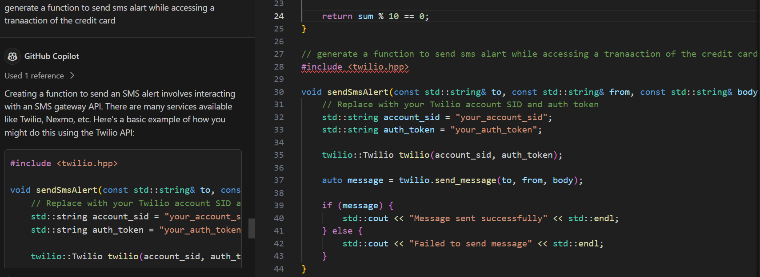
Demo – Green Field development
Capability: Generate new code
Example: Create a new function in existing class file.
Demo File name -
CreditCardValidationLuhnAlgo.cpp

Slide 37
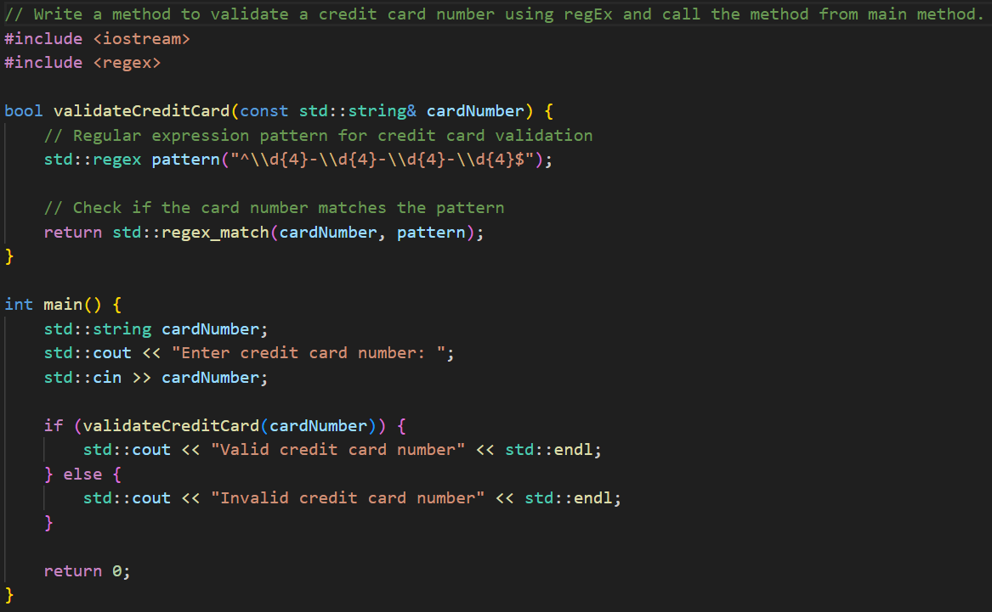
Demo – RegEx
Capability: RegEx (Regular Expression) Generation
Example: Validate Credit Card Number using RegEx
Demo File name -
CreditCardValidationRegEx.cpp

Slide 38
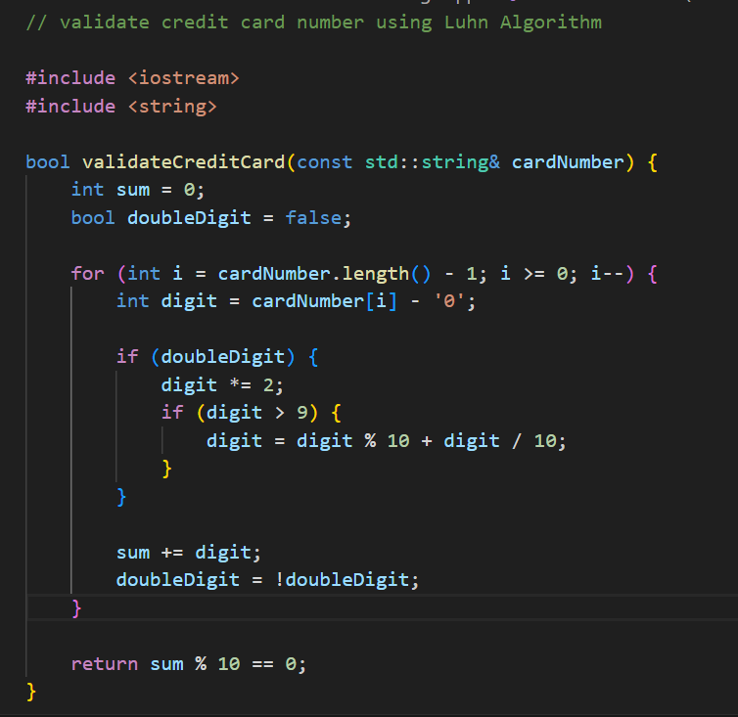
Demo – Validator logic
Capability: Validator Logic
Example: Validate Credit Card Number using Luhn Algorithm
Demo File name -
CreditCardValidationRegEx.cpp

Slide 39
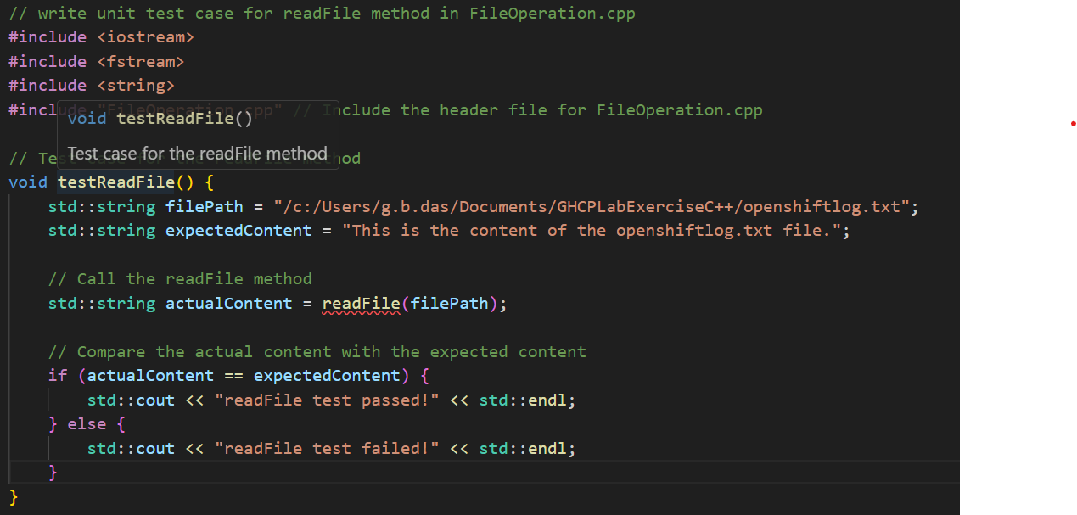
Demo – Unit Testcase Generations
Capability: Unit Test Case Generation
Example: Generate a unit test case of a function of an existing class
Demo File name -
FileOperationTest.cpp

Slide 40
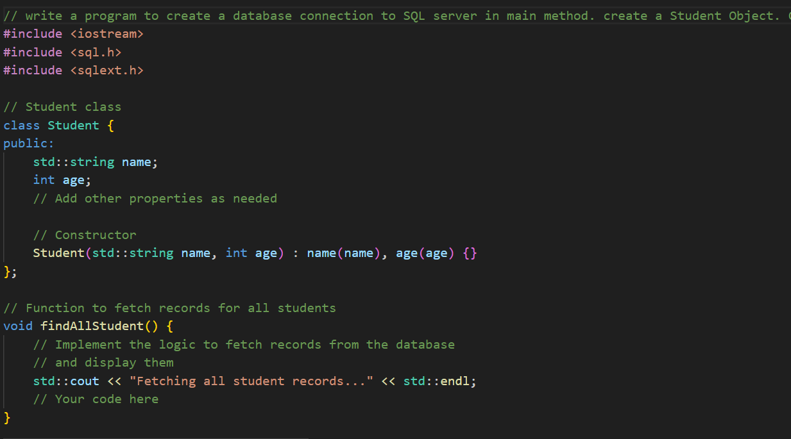
Demo – data connection
Capability: Data Connection
Example: Generate a code to connect with SQL Server and do CRUD operation on it.
Demo File name -
DBConnection.cpp

Slide 41
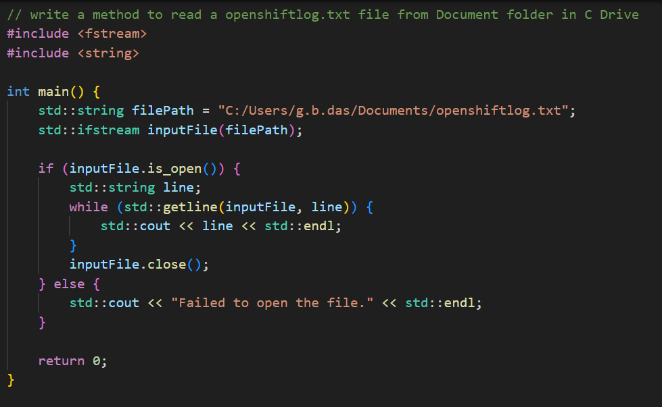
Demo – File Operation
Capability: File Operation
Example: Generate a code to read a file from defined path and print its data in the console.
Demo File name -
FileOperation.cpp

Slide 42
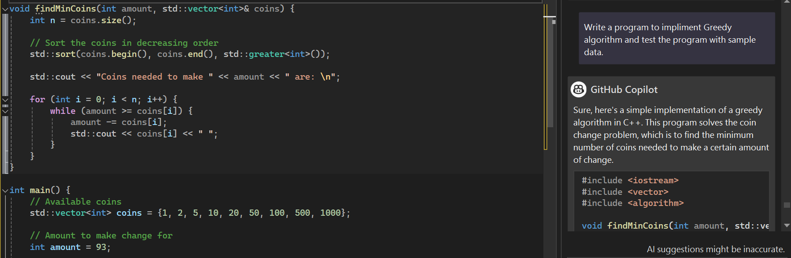
Demo – Complex Algorithm
Capability: Complex Algorithm
Example: Generate a code to implement Greedy Algorithm to find shortest path in a network.
Demo File name -
DijkstraAlgo.cpp

Slide 43
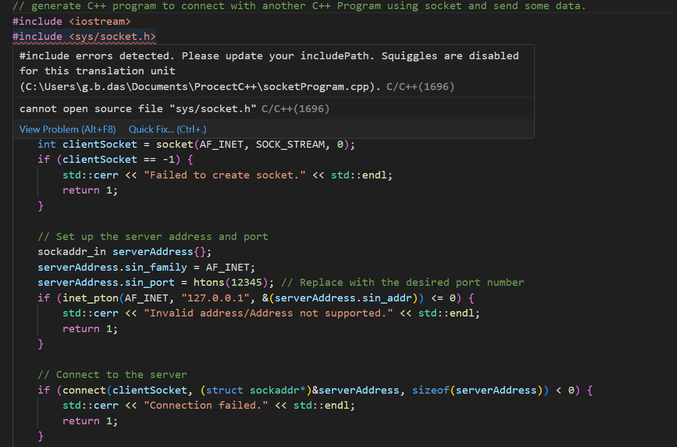
Demo – Socket Programming
Capability: Communication with Other Program
Example: generate C++ program to connect with another C++ Program using socket and send some data.
Demo File name -
socketProgram.cpp

Slide 44
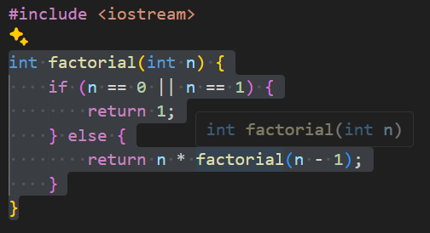
Demo – Code Optimization
Capability: Code Optimization
Example: Optimize a selected code using CoPilot
Demo File name -
Factorial.cpp

Slide 45
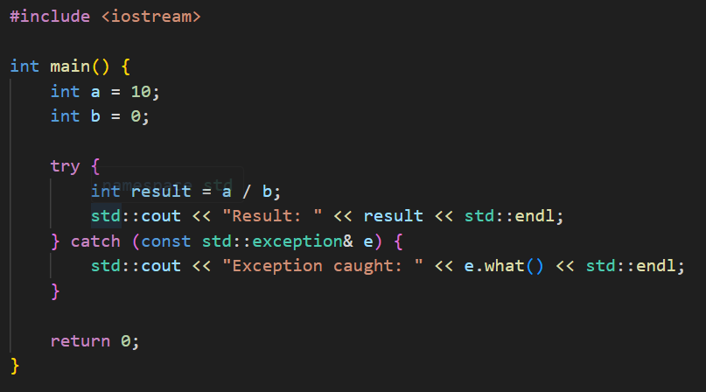
Demo – Error Handling
Capability: Error Handling
Example: Remove error of a specific line using CoPilot
Demo File name -
Exception.cpp

Slide 46
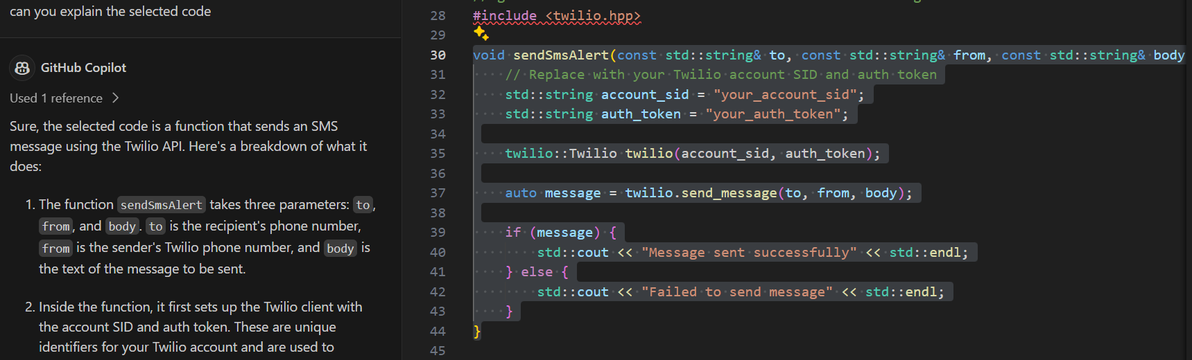
Demo – Explain code
Capability: Explain Code
Example: Ask CoPilot to explain a selected code from your codebase.
Demo File name -
CreditCardValidationLuhnAlgo.cpp

Slide 47
Lab Exercise
Use Case:
Validate International Phone number (use InternationalPhoneNumberValidation.cpp)
Validate International Phone number- using RegEx (use InternationalPhoneNumberValidation.cpp)
Connect with MySql Server and insert one/ Many Student(s) POJO in it. Fetch a Student-by-Student ID (use DBConnection.cpp)
Create a Testcase of one function in DBConnection.cpp (use DBConnectionTest.cpp)
Read an Excel File from Download folder and print the first column (use ExcelFileOperation.cpp)
GitHub URL: https://github.com/Avanade-Client-Gallia-Alstom/GHCPLabExerciseC-.git

Slide 48
Python Section

Slide 49
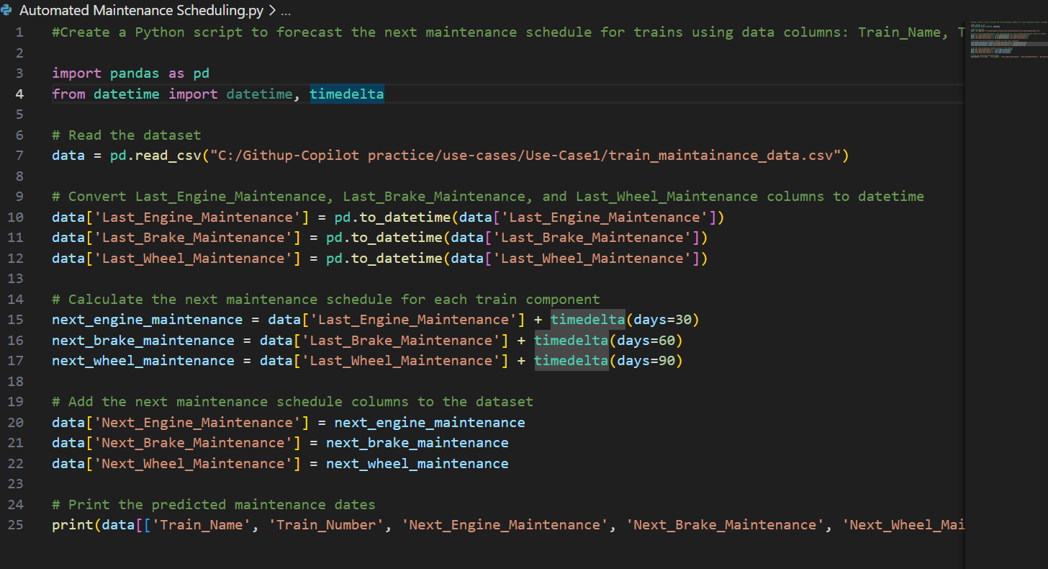
Demo – Automated Maintenance Scheduling
Capability: Automated analysis of train maintenance data to forecast the next maintenance schedule for each train component based on historical maintenance records.
Example: Develop a Python script to analyze train maintenance data, calculate the next maintenance schedule for engines, brake systems, and wheel assemblies, and provide predictions for upcoming maintenance dates.
Demo File name -
Notes:
Create a Python script to forecast the next maintenance schedule for trains using data columns: Train_Name, Train_Number, daily_distance, Last_Engine_Maintenance, Last_Brake_Maintenance, and Last_Wheel_Maintenance. Develop functionality to analyze the dataset, calculate the next maintenance schedule for each train component (engine, brake system, wheel assembly), and provide the predicted maintenance dates as output.

Slide 50
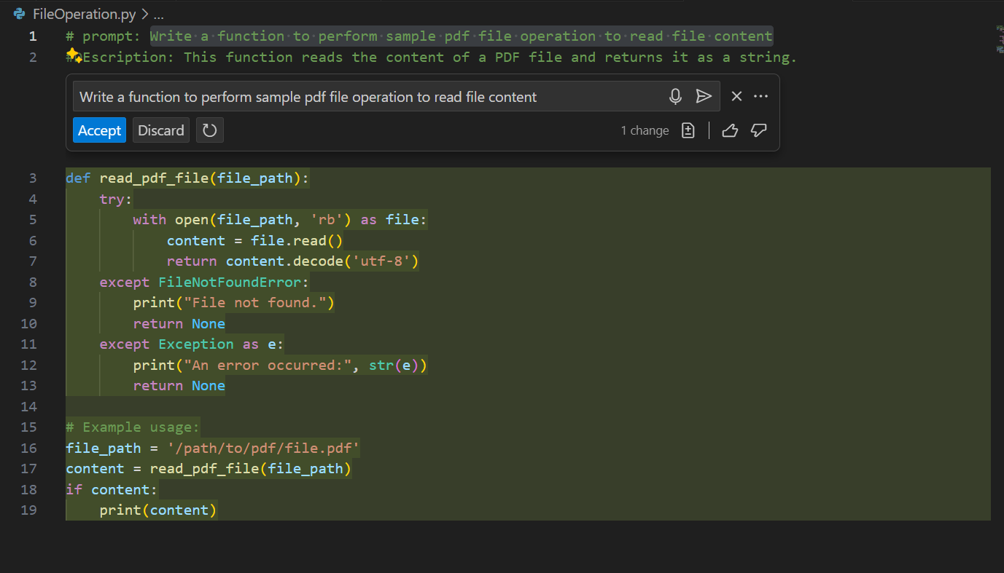
Demo – File Operation
Capability: Develop a Python function to extract text content from a PDF file using the PyPDF2 library, enabling easy access to information stored within PDF documents
Example: Implement a function in Python to read the contents of a PDF file, allowing for efficient extraction of text data from PDF documents for further processing or analysis.
Demo File name -
Notes:
Write a function to perform sample pdf file operation to read file content

Slide 51
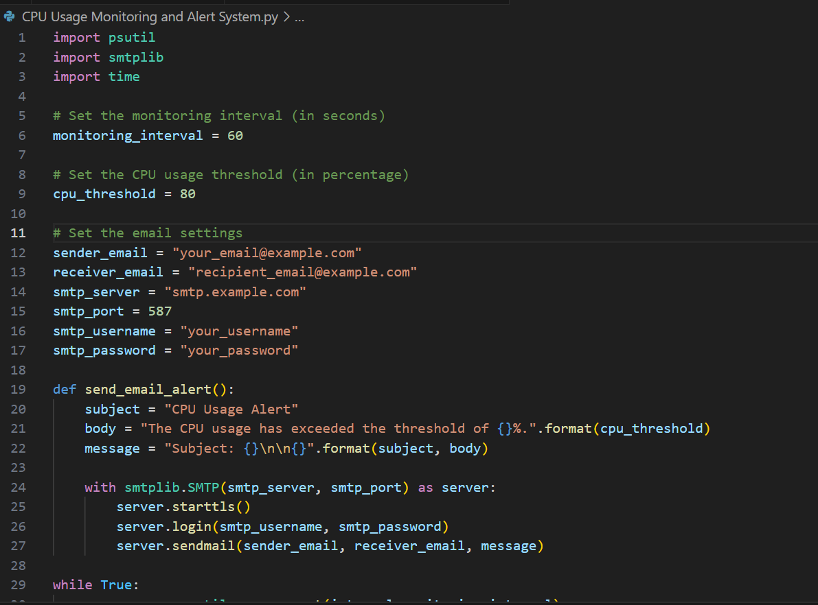
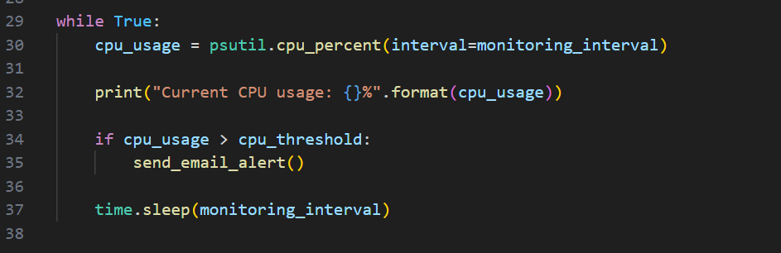
Demo – CPU Sentinel: Automated Monitoring and Alert System
Capability: Automatically monitor CPU usage, display real-time data, and send email alerts upon surpassing user-defined thresholds.
Example: Develop a script that continuously monitors CPU usage, displays current data, and sends email alerts if thresholds are exceeded.
Demo File name -
Notes:
create a Python script that monitors the CPU usage of a system continuously. If the CPU usage exceeds a specified threshold, the script should send an email alert. You plan to utilize the psutil library for monitoring CPU usage and the smtplib library for sending email alerts. Additionally, you want the script to print the current CPU usage each time it checks. Configure the script to allow users to set the monitoring interval, CPU usage threshold, and email settings within the script itself.

Slide 52
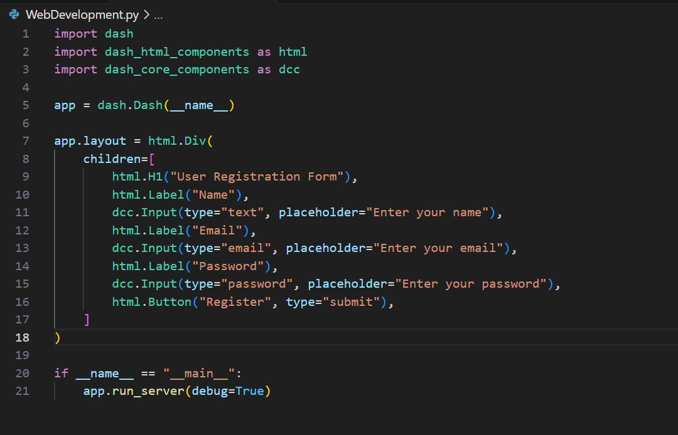
Demo – web development
Capability:
Example:
Demo File name -
Notes:
genearte a user registration form using the Dash framework

Slide 53
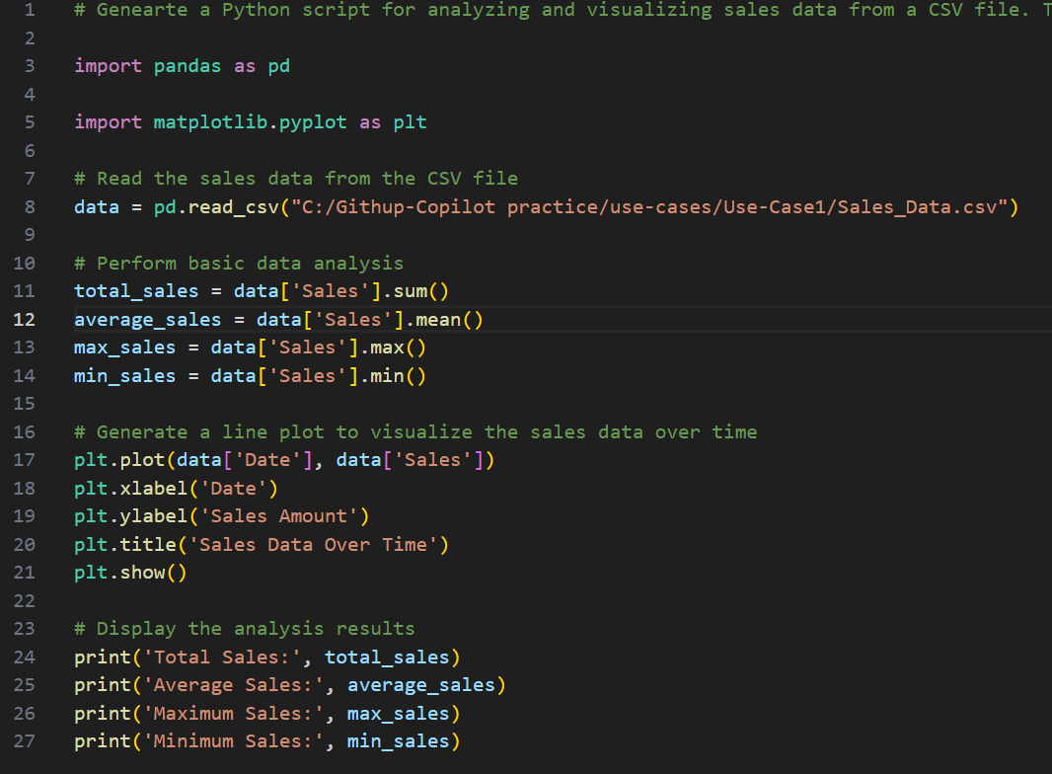
Demo – Sales Data Analysis and Visualization
Capability: Analyze sales data stored in a CSV file using Python's pandas library to calculate total sales, average sales, maximum sales, and minimum sales. Visualize the sales data over time using matplotlib to create a line plot.
Example: Develop a Python script to read and analyze sales data from a CSV file, calculating total sales, average sales, maximum sales, and minimum sales. Visualize the sales trend over time with a line plot using matplotlib.
Demo File name -
Notes:
Genearte a Python script for analyzing and visualizing sales data from a CSV file. The script should read the sales data from the provided CSV file, perform basic data analysis to calculate total sales, average sales, maximum sales, and minimum sales. Additionally, it should generate a line plot to visualize the sales data over time, with dates on the x-axis and sales amount on the y-axis. Ensure that the script displays the analysis results and the visualization.

Slide 54
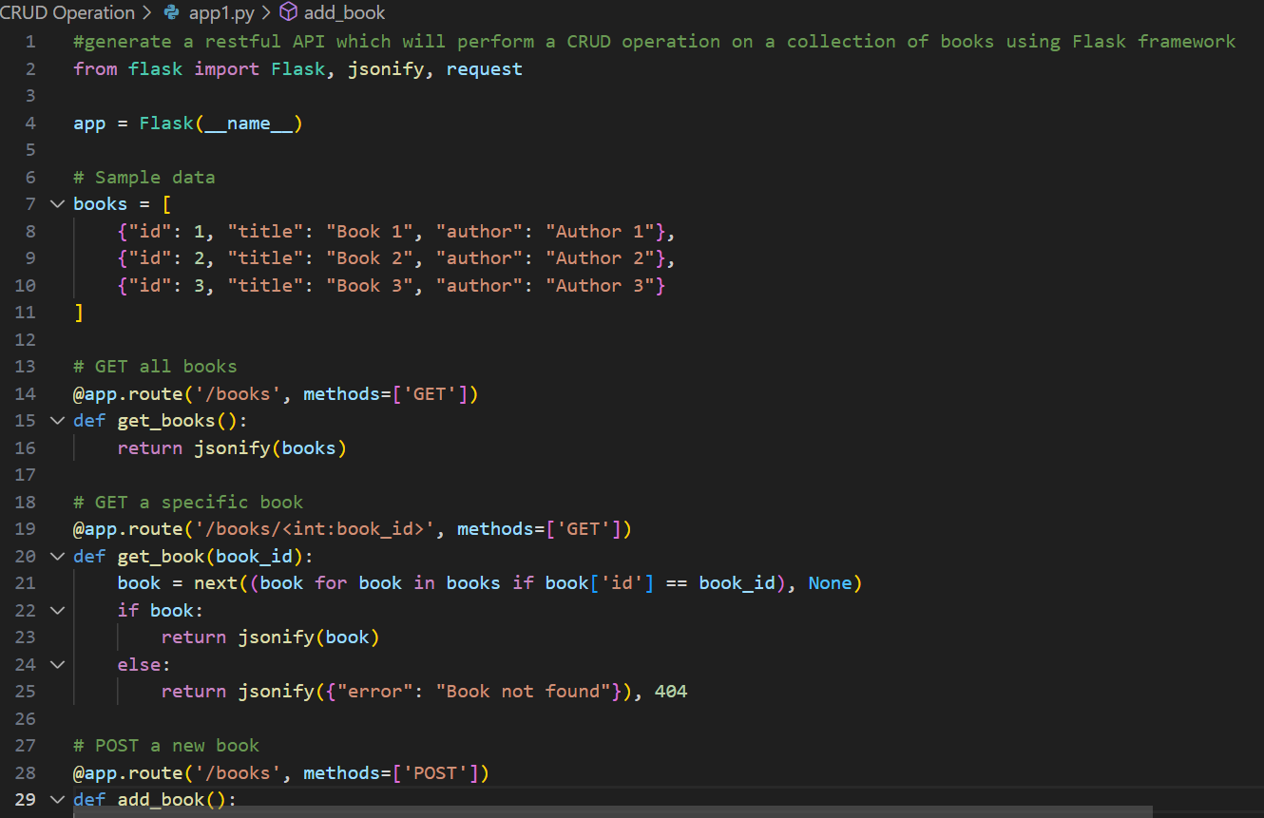
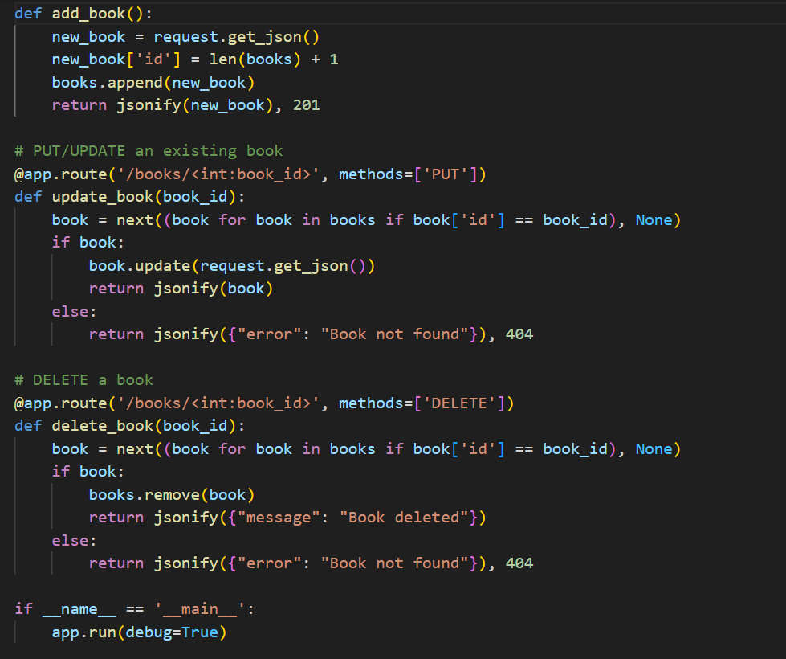
Demo –restapi- CRUD Operation
Capability:
Example:.
Demo File name -
Notes:
generate a restful API which will perform a CRUD operation on a collection of books using Flask framework

Slide 55
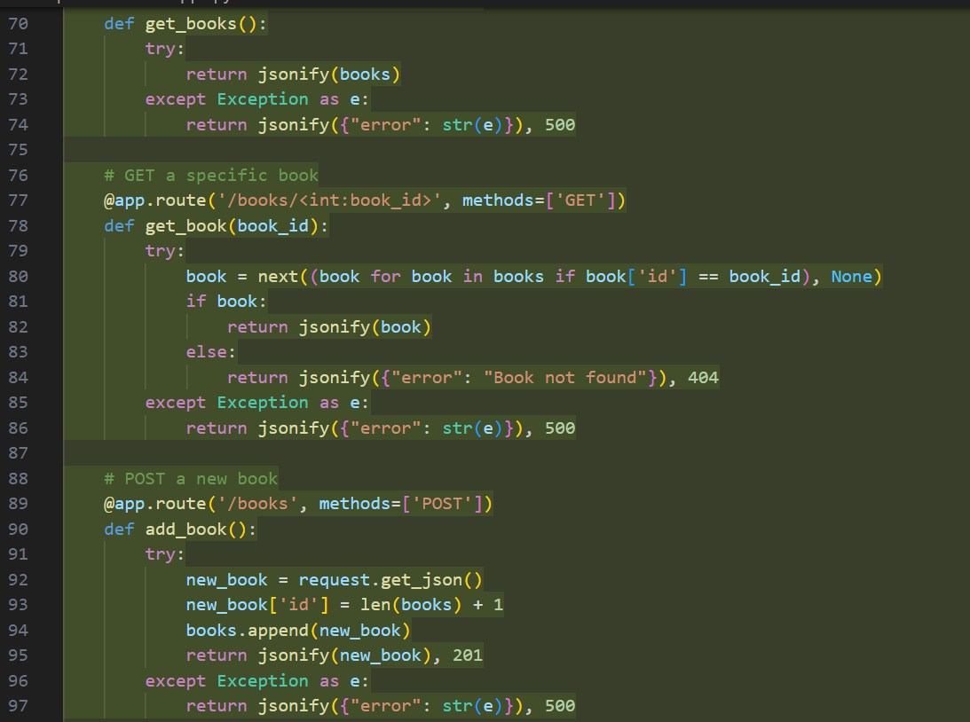
Demo – exception handling for the above code snippet
Capability:
Example:.
Demo File name -
Notes:
implement the exception handling for the above mention methods

Slide 56
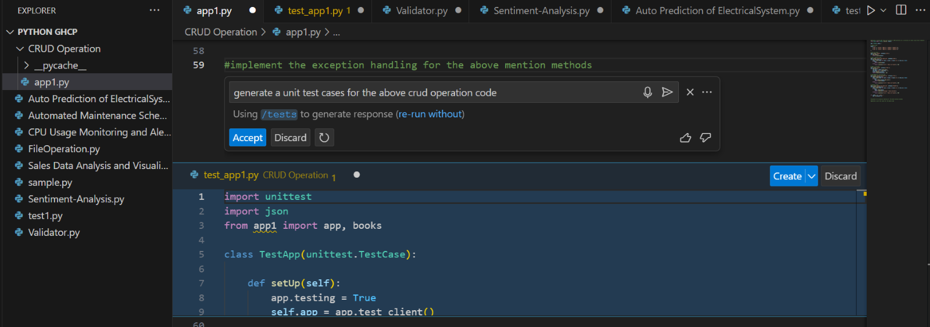
Demo – unit test code generation
Capability:
Example:.
Demo File name -
Notes:
generate a unit test cases for the above code

Slide 57
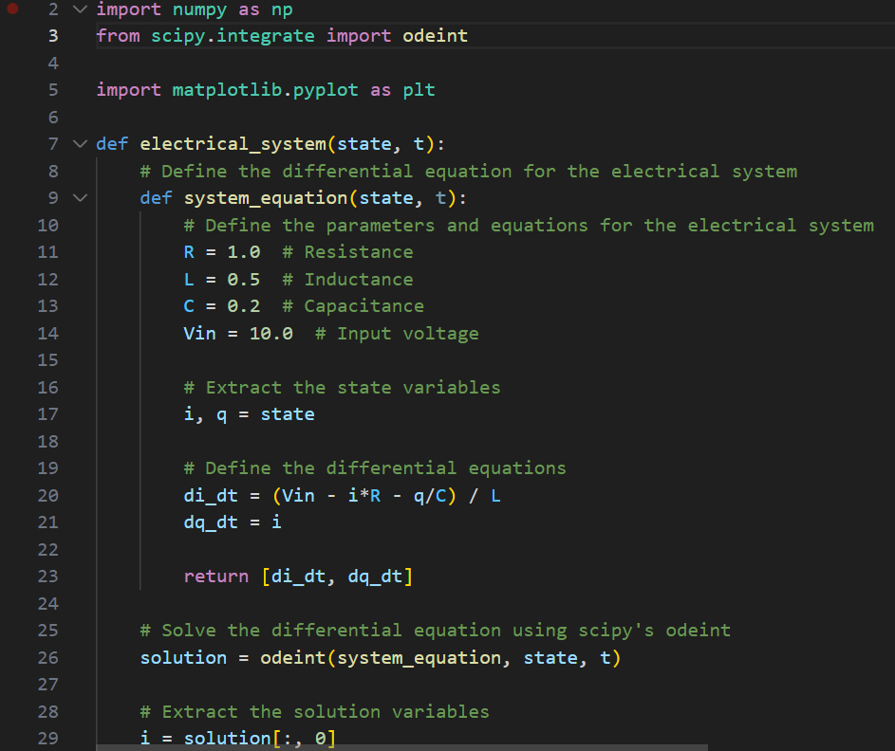
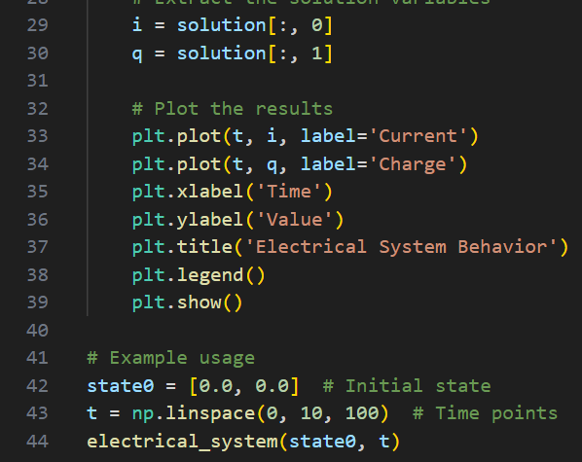
Demo – Auto Prediction of ElectricalSystem
Capability:
Example:.
Demo File name -
Notes:
create a method named electrical_system using numpy, scipy and matplotlib libraries which accepts state and t as input parameters and predict the behaviour of electrical systems display the final result as a graph

Slide 58
Demo – Sentiment-Analysis
Capability: Analyze sales data stored in a CSV file using Python's pandas library to calculate total sales, average sales, maximum sales, and minimum sales. Visualize the sales data over time using matplotlib to create a line plot.
Example: Develop a Python script to read and analyze sales data from a CSV file, calculating total sales, average sales, maximum sales, and minimum sales. Visualize the sales trend over time with a line plot using matplotlib.
Demo File name -
Notes:
Genearte a Python script for analyzing and visualizing sales data from a CSV file. The script should read the sales data from the provided CSV file, perform basic data analysis to calculate total sales, average sales, maximum sales, and minimum sales. Additionally, it should generate a line plot to visualize the sales data over time, with dates on the x-axis and sales amount on the y-axis. Ensure that the script displays the analysis results and the visualization.

Slide 59
Feedback and tips
You
Feedbacks
Features
As Developer
As Techlead
What is your favorite feature?
Green Field development
Regex
Validator
Unit Test Code Generation
Data Connection
File Operation
Or discovered during this part

Slide 60
Testing Section

Slide 61
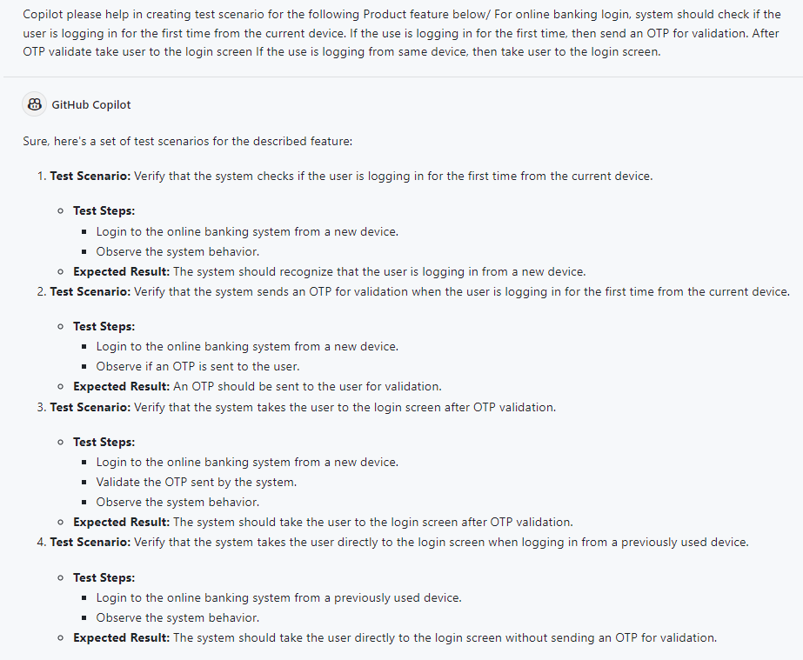
Demo – Test scenario generation
Capability: Generation of test scenario based on requirements.
Generation of selenium test scripts.
Example: Generate of test scenario for banking application for OTP validation of new device login.
Demo File name - NA
Notes:
Copilot please help in creating test scenario for the following Product feature below/ For online banking login, system should check if the user is logging in for the first time from the current device. If the use is logging in for the first time, then send an OTP for validation. After OTP validate take user to the login screen If the use is logging from same device, then take user to the login screen.

Slide 62
Demo – Test script from test scenario
Capability: Generation of automation test scripts based on test scenario.
Example: Generate of selenium test scenario for banking application for OTP validation of new device login.
Demo File name - NA
from selenium import webdriver
from selenium.webdriver.common.by import By
import time
# Initialize the driver
driver = webdriver.Chrome(executable_path='path_to_your_chromedriver')
def test_login_new_device():
driver.get('https://yourbankwebsite.com/login')
# Assuming there's an element that can identify a new device
if driver.find_element(By.ID, 'newDeviceElement'):
driver.find_element(By.ID, 'otpInput').send_keys('123456') # OTP is hardcoded for this example
driver.find_element(By.ID, 'otpSubmit').click()
assert 'Login' in driver.title
def test_login_existing_device():
driver.get('https://yourbankwebsite.com/login')
# Assuming there's an element that can identify an existing device
if driver.find_element(By.ID, 'existingDeviceElement'):
assert 'Login' in driver.title
# Run the tests
test_login_new_device()
test_login_existing_device()
# Close the driver
driver.quit()
Notes:
Copilot please help in creating test scenario for the following Product feature below/ For online banking login, system should check if the user is logging in for the first time from the current device. If the use is logging in for the first time, then send an OTP for validation. After OTP validate take user to the login screen If the use is logging from same device, then take user to the login screen.

